Slide 1
Machine Learning - Introduction
Feature, Label, Data Set and Prediction

Slide 2
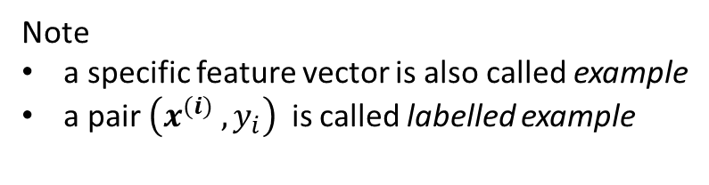
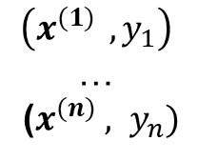
Features Set, Label, Data Set
transform input data and result to a set of (x, y) pairs,
where x is a vector (derived from input data) and y a number (the result)
$$\left({x^{(1)}}_{ },y_{1}\right)$$
…
($x^{(n)} , y_{n})$
„feature vector“
(the vector x)
„label“
(the y value)
„data set of labeled examples“
(the set of all (x,y)-pairs
Note
a specific feature vector is also called example
a pair $\left({x^{(i)}}_{ },y_{i}\right)$ is called labelled example

